Slide 1
Capstone Project Student’s Early Attrition Modelling for Clearwater State University
Ruchi Manoj Porwal
FSDS- April 2020

Slide 2
Table of Content
1
Executive Summary
2
The Problem Statement
3
Data Pre-processing & Feature Engineering
4
Data Insights & Exploratory Data Analysis
5
Key Drivers / Feature Selection
6
Methodology Used ,Main Results & Conclusion
7
Recommendations to the University
8
Appendix – A , Appendix – B and Appendix - C

Slide 3
Executive Summary
3400 students have enrolled between 2005 to 2010
Age distribution varies between 16 yrs to 26 yrs. Major enrolment happens between 17 yrs to 19 yrs
Female to Male admission ratio is 63% to 37%
Intake of International students is negligible (~0.76% )
54 major courses are offered during 1st year
42% students are staying within the campus
High School GPA varies from 1.87 to 4.0 with mean & median value of 3.2
Parents educational qualification varies from Middle/High School to College

Slide 4
Problem Statement
A predictive approach to identify students who are at risk of early attrition.
Identify key drivers of early attrition to improve retention rate and in turn improve university’s performance.

Slide 5
Data Pre-processing & Feature Engineering
Variables from Table-1 has been deleted because of high percentage of missing values (>15%)
Variables from Table-2 has been deleted because of duplication with other variables
Performed Feature Engineering on Table-3 variables

Slide 6
Data Pre-processing & Feature Engineering continued.. (Missing value, Zero-value and Outlier handling)
Table-4 represents imputation strategy for categorical variables
Table-5 represents missing value, zero value and outlier handling methods

Slide 7
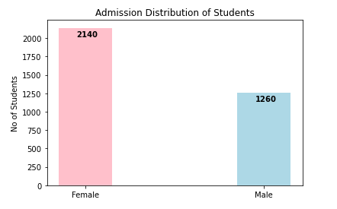
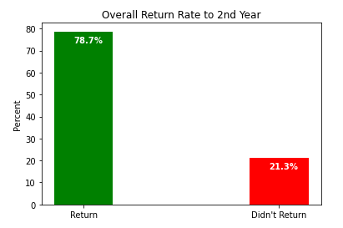
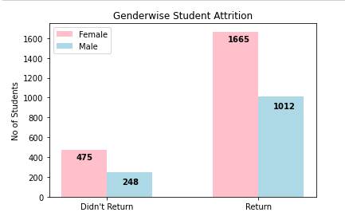
Data Insights and EDA
2140 Female and 1260 Male students enrolled between 2005 to 2010
Overall attrition rate is 21%
475 Female and 248 Male (Total of 723) students didn’t return back to 2nd Year

Slide 8
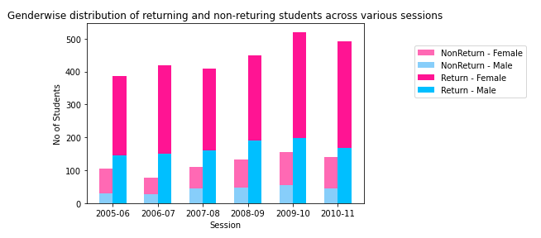
Data Insights and EDA continued..
Attrition Rate seems to be constant across various sessions and both Gender ~ 21%

Slide 9
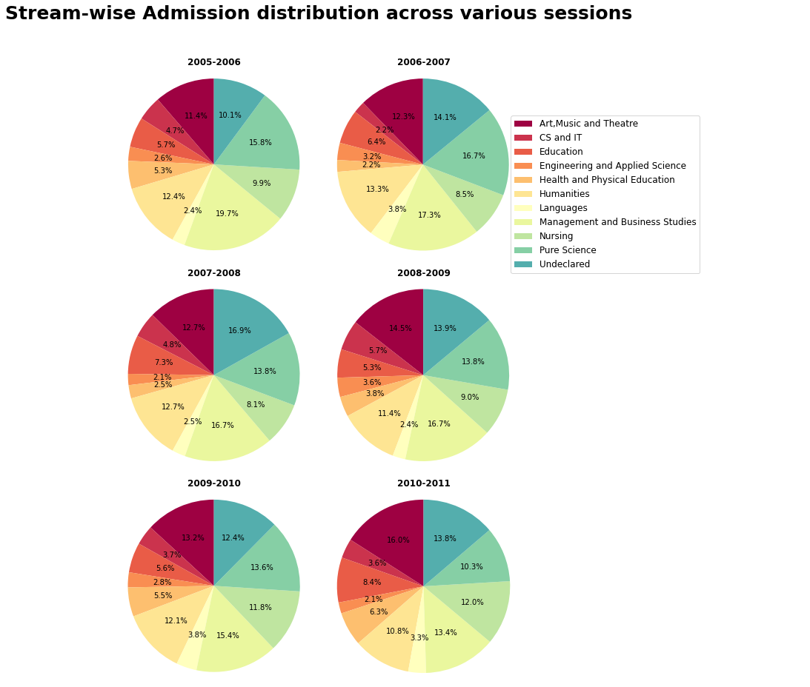
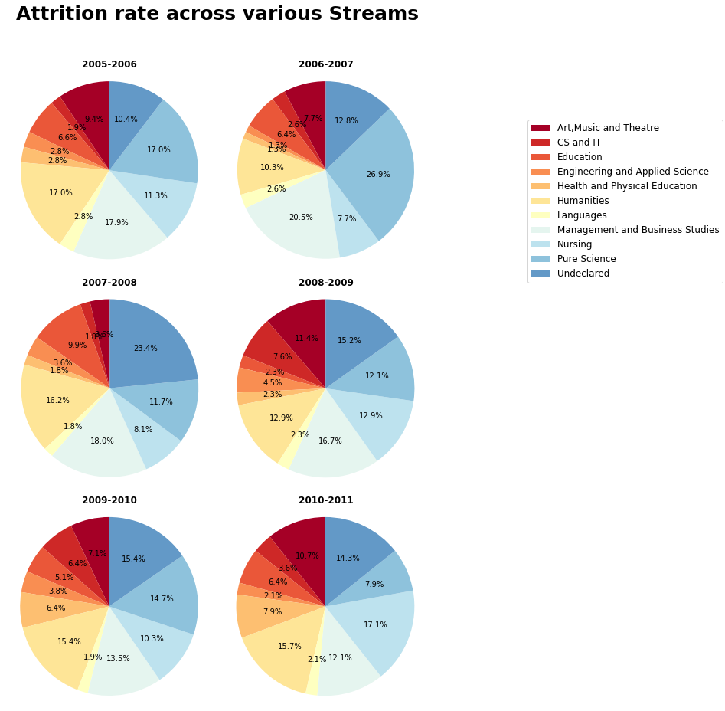
Data Insights and EDA continued..
Management & Business Studies, Pure Science, Humanities, Nursing and Art,Music & Theatre are the major streams for Admission and Attrition as well
Undeclared stream account for 10 to 16% of total admission and attrition (23% in 2007-08)

Slide 10
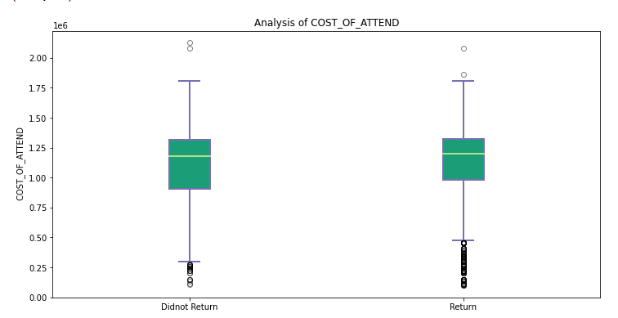
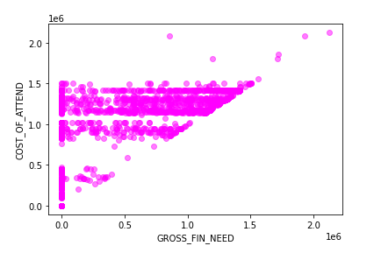
Data Insights and EDA continued..
GROSS_FIN_NEED, COST_OF_ATTEND, EST_FAM_CONTRIBUTION & UNMET_NEED are the 4 numerical variables and detail analysis has been done.
There is a strong correlation between them. GROSS_FIN_NEED has been deleted to avoid multicollinearity
No effect of COST_OF_ATTEND on returning and non-returning students

Slide 11
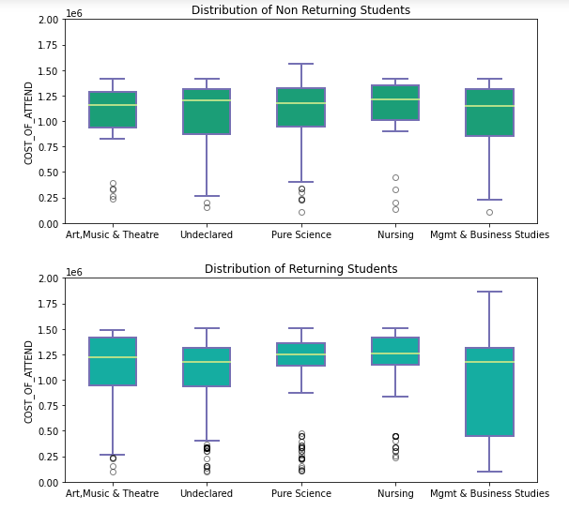
Data Insights and EDA continued..
Approx. 50% of COST_OF_ATTEND is having zero values
Further analysis of 5 major STREAMS with COST_OF_ATTEND reveals that different STREAMS have different COST_OF_ATTEND
Outliers has been replaced with the lower/upper quartile value for corresponding SESSION & STREAM combination
Zero values has been replaced with median value for corresponding SESSION & STREAM combination
COST_OF_ATTEND has been converted into FEES variable

Slide 12
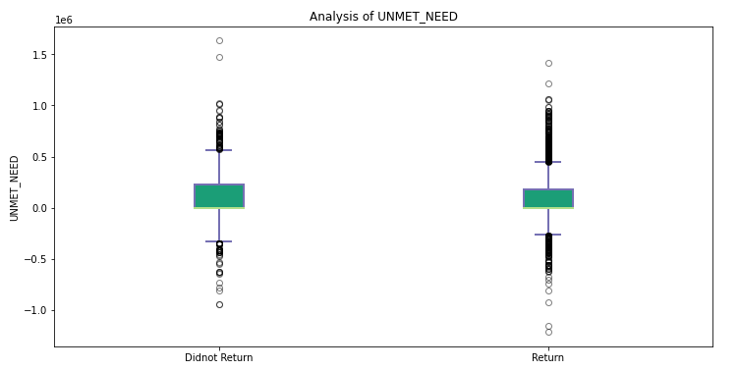
Data Insights and EDA continued..
There seems to be no difference between returning & non-returning students for UNMET_NEED, so converting it into categorical variable “UNMET_NEED_FLAG”, which takes value “1” when there is a positive value for UNMET_NEED, otherwise it is “0”
No effect of EST_FAM_CONTRIBUTION on returning & non-returning students

Slide 13
Key Drivers / Feature Selection
Feature selection is a process of identifying and selecting features from data that contribute most to the prediction of dependent/response/output variable
Univariate selection using Chi-square test of independence between dependent variable “RETURNED_2ND_YR”, which takes value [0,1] and categorical independent variables has been done
Spearman’s rank correlation has been done between “RETURNED_2ND_YR” and numerical independent variables
Used python’s SelectKBest functionality from sklearn module to get key features
Details of Chi-square test, Spearman’s Rank correlation and SelectKBest are in Appendix-A

Slide 14
Key Drivers / Feature Selection
Key Categorical Drivers are-
STDNT_BACKGROUND,
IN_STATE_FLAG, STREAM,
CORE_COURSE_GRADE_1_F, CORE_COURSE_GRADE_2_F,
CORE_COURSE_GRADE_1_S, CORE_COURSE_GRADE_2_S,
HOUSING_STS, SESSION,
INTERNATIONAL_STS
Non-key Categorical Drivers & can be removed are-
FATHER_HI_EDU_CD,
MOTHER_HI_EDU_CD,
DEGREE_GROUP_CD
Key Numerical Drivers are-
HIGH_SCHL_GPA,
FIRST_TERM_EARNED_HRS,
SECOND_TERM_ATTEMPT_HRS,
SECOND_TERM_EARNED_HRS
Non-key Numerical Drivers and can be removed are –
STDNT_AGE,GROSS_FIN_NEED,
FIRST_TERM_ATTEMPT_HRS,
EST_FAM_CONTRIBUTION
In spite of non-key drivers kept FIRST_TERM_ATTEMPT_HRS and STDNT_AGE as a features

Slide 15
Methodology Used
Flipped “RETURNED_2ND_YR” and converted into “NON_RETURNED_2ND_YR”,which is “1” for non-returning students and “0” for returning students
Being a classification problem, various methodologies like Logistic Regression with SMOTE (imbalanced class ratio), Random Forest, Gradient Boosting, AdaBoost, XGBoost has been implemented
Confusion matrix has been generated for each techniques. Accuracy,Precision,Recall and F1-Score has been used to evaluate each model.
Since our goal is to predict attrition, Recall or Sensitivity score is most important. It is a True Positive Rate
For each technique hyper parameters have been chosen by GridSearch method using cross validation (CV)
Details of results are present in Appendix-B

Slide 16
Main Results
Our goal is to maximize Recall, since undetected attrition are what actually creates costs for the university and students
Recall/TPR is maximum for XGBoost classifier. It is chosen as final model for prediction
Increasing sensitivity will also increase ‘false alarm’, which can be kept small by high precision. Hence F1-score has been maximized in order to make balance between Precision and Recall
Hyper parameters for XGBoost has been tuned to achieve maximum F1-score,therefore maximizing Precision and Recall at the same time

Slide 17
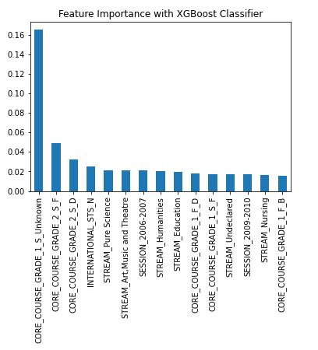
Conclusion
From XGBoost model results following conclusions can be drawn-
CORE_COURSE_GRADE_1_S is the most important feature contributing towards attrition. “Unknown” is the grade for which attrition is maximum
CORE_COURSE_GRADE_2_S is the 2nd most important feature. Grade “F” & “D” sees maximum attrition
STREAM is also contributing towards attrition. “Pure_Scence” sees maximum attrition
Academic performance in the Core Course 1 and Core Course 2 is mainly responsible for early attrition

Slide 18
Recommendations to University
Based upon the XGBoost model results recommendations to university are following –
Early intervention to improve academic performance in core course 1 & 2 during second semester can improve students retention rate. Probability of attrition for every student ID has been generated, which will help to take appropriate and timely decision (Refer Appendix –C (‘result.csv’))
“Pure_Science” Stream which corresponds to Biology,Chemistry and Mathematics as major subject needs more attention from university. This stream accounts for ~(14 -16%) of admission but attrition rate 27% in 2006-2007 session. Since this stream needs more facilities so better infrastructure and faculty will help to improve (Refer – Slide #9)
“Undeclared” Stream accounts for ~ (14-17%) of admission rate. Better stream declaration at the time of enrolment will help to improve
Approximately 50% of data for fees and family’s contribution towards education is Zero. Less values in these fields will present challenges in appropriate analysis towards financial status of student and attrition rate

Slide 19
Recommendations to University (continued)
Intake of International Students is very negligible (~0.76%), so focus towards proper advertisement for the courses offered by university through online channels and social media will help to attract international students
95% of students came within 200 miles from university and 90% came from same state. Marketing and Advertisement will help to attract more number of students from far distance and other states
Only 42% of students are staying within campus. There is an scope for offering more number of “IN-CAMPUS” courses by focusing on better infrastructure
Focus towards “CS & IT” , “Engineering & Applied Science” and “Health & Physical Education” can gain more admission rate. Currently combined together contributing ~15% of admissions
Better data collection for Core courses 3,4,5 & 6 in both semesters and financial data can still improve the quality of analysis

Slide 20
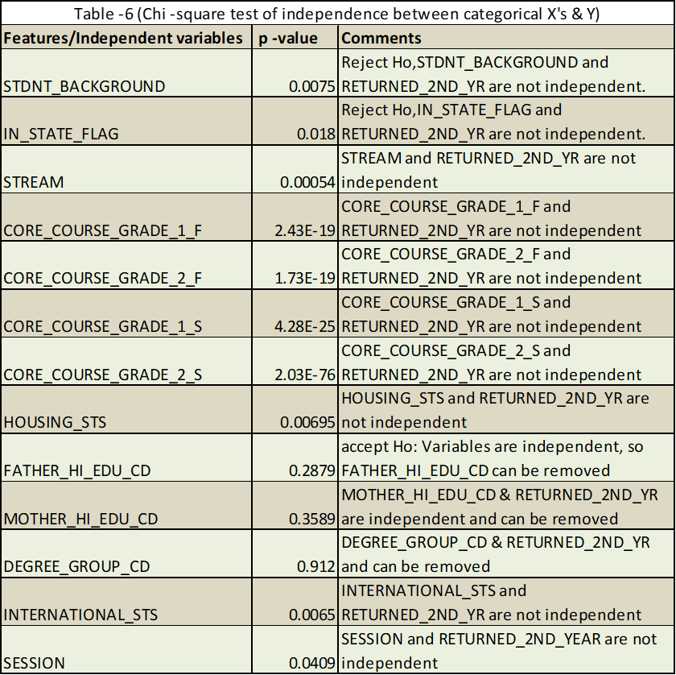
Appendix-A

Slide 21
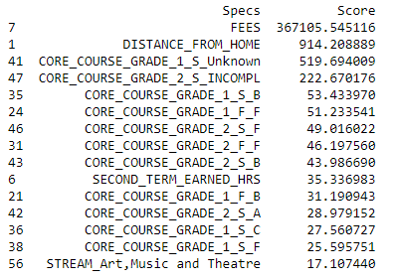
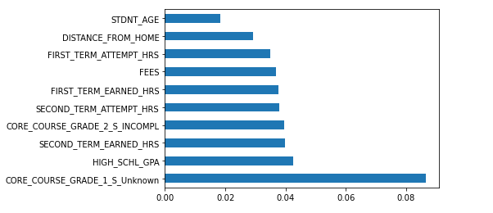
Appendix-A

Slide 22
Appendix-B (Confusion Matrix)
Hyper parameters for XG Boost has been chosen for maximizing F1-score
Different probability threshold values can be chosen to suit our requirement for Precision and Recall

Slide 23
Appendix-C
Thank You

